Slide 1

Kenyan Online Freelance Marketplace
By Paul Onteri
A research project submitted in partial fulfilment of the requirements for the award of the degree of Bachelor of Science in Computer Science.

Slide 2
1. Background of research
In Kenya, we have large numbers of professionals complaining that they cannot get jobs.
Companies also claim that they are struggling to find skilled professionals. They need the above mentioned professionals but are afraid of making long term commitments with individuals without sufficient experience due to legal risk and the cost of managing human capital. .
A chicken and egg problem. Jobs require experience and professionals require jobs to get experience.
To overcome this problem, a freelancing marketplace can be used. It will connect talented individuals with economic opportunities and help organisations cut down on the cost of managing human capital by getting professionals to work for them on a short-term basis.
Notes:
In Kenya, we have large numbers of professionals complaining that they cannot get jobs. These professionals are graduating with skills in software development, writing, data entry, design, sciences, sales and marketing, accounting, legal services, etc. They, however, struggle to get started and gain experience in such high-in-demand industries. It is because the jobs require experience and they require jobs to get experience. Companies also claim that they are struggling to find skilled professionals. (Roussi and Financial Times, 2021) We have multiple companies and organisations that need the abovementioned professionals but are afraid of making long term commitments with individuals without sufficient experience due to legal risk and the cost of managing human capital. To overcome these problems, a freelancing marketplace can be used. It will connect talented individuals with economic opportunities and help organisations cut down on the cost of managing human capital by getting individuals to work for them on a short-term basis. This is already being used in Europe and in the USA wherein 2019, an MBO Partners’ survey found that nearly 41.1 million Americans identified themselves as freelancers, whether it was a few hours a month or a full-time arrangement. To break that down a little further, nearly 15 million workers claimed to be part-time freelancers, and 12.4 million called themselves full-time freelancers! (MBO Partners, 2019)

Slide 3
2. Problem statement
We have a huge number of professionals graduating with high in-demand skills. They, however, struggle to get started and gain experience in these industries. Jobs require experience and they require jobs to get experience. The technology used in the hiring and selection process is not optimised to showcase their potential. It majorly focuses on experience. We also have multiple companies and organisations that need such professionals but are afraid of making long term commitments with individuals without sufficient experience due to legal risk and the high cost of managing human capital. To overcome this problem, a digital freelancing marketplace can be created that will connect talented individuals with economic opportunities and help organisations cut down on the cost of managing human capital by getting individuals to work for them on a short-term basis.

Slide 4
3. Aim of research
Create a digital freelancing marketplace that will connect talented professionals with economic opportunities and give organisations access to affordable and low-risk human capital.

Slide 5
4. Objectives of research
To review related marketplaces built for use in Europe and the USA. Then identify their strengths and weaknesses.
To explore the known existing research done and unlock unknown possibilities of the research.
Develop a logical design for the proposed system.
To create a user interface design, database design, UML diagrams and a conceptual architecture for the proposed system.
To implement and test the system and come up with an evaluation plan.

Slide 6
5. Scope of the research
1. Allow freelancers to have online profiles.
2. Allow freelancers to be paid via easy methods like M-Pesa.
3. Money to be held in escrow to help in preventing fraud.
4. Allow companies, organisations and individuals (job posters) to post jobs.
5. Allow the job posters to receive bids on the job from qualified freelancers.
6. Allow the job posters to review freelancer profiles to help them with the selection.
7. After being given a job freelancers work then submit when done. The client has the right to reject/approve the work.
8. Ratings and reviews for both clients and freelancers after jobs.
9. Notifications. The system should be able to notify the freelancers and job posters of actions that require their attention.
10. Admin section and generation of reports. There should be an admin app that can be used to manage customers, freelancers and postings. There will be reports like jobs posted, user logs, etc.

Slide 7
6. Research methodology
The research will go through materials in the date range of the years 2000 – 2022 like books, recent research on such systems as well as an overview of other similar websites in Europe and the USA.
The system analysis will use Data Flow Diagrams and Flow charts. We also use ERD diagrams, UML diagrams and Use case diagrams for the system design.
The system will be implemented using various technologies like PHP, HTML, CSS, JavaScript and MySQL.

Slide 8
7. Review of related work
The main aim of here is to review research related to freelance and work as well as go through companies that offer freelance marketplaces seeing their features and critique them. It will involve a deep entry into the field, going to search engines and input some of the keywords related to your project.
We went through a thorough review of current and past systems and saw the past and current state of the work done in our research area.
Though there are some digital marketplaces, we have seen that they do not cater for the regular Kenyan graduate and may be very complicated to use. We should keep up with the emerging trends like remote work and hiring.

Slide 9
8. Database Design
This was done with the help of an ERD diagram that is in next slide.

Slide 10
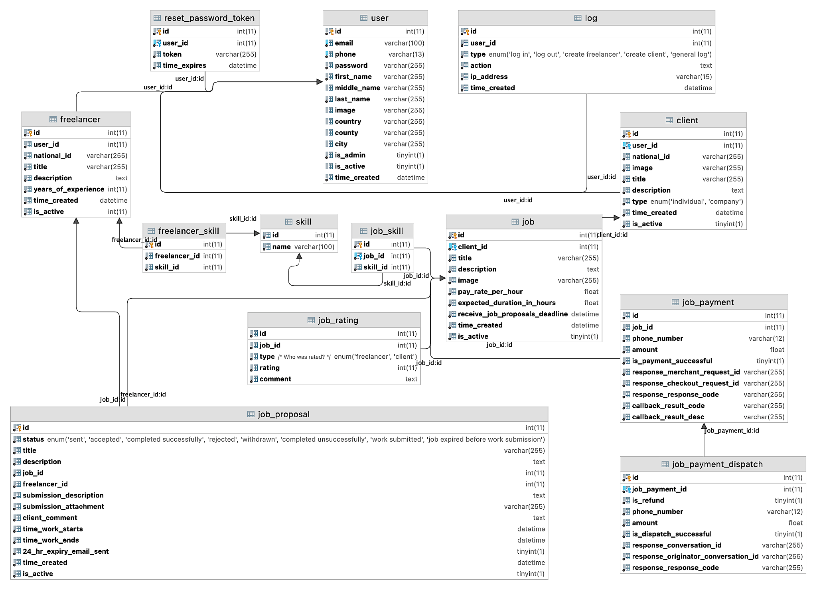

Slide 11
9. Conclusion
Clients and freelancers can now with a click of a few buttons and browser interactions join a platform that truly works towards achieving a goal of connecting talented professionals with economic opportunities and giving organisations access to affordable and low-risk human capital.
People can now utilize their skillset and make a living out of them, dependent on how well they advance in the freelance community.
Organizations on the other hand have a huge pool of competent individuals willing to put in the work, and support them as if they were employed by them.

Slide 12
10. Challenges
1. Some users were unwilling to help in the interviewing and filling in questionnaires.
2. Unwillingness by some to move from a manual system to an automated system.
3. The MPesa Payments V1 API used for payments has some bugs (especially in the testing environment). The Callback URL is sometimes not called.

Slide 13
11. Future recommendations
1. An online communication platform should be added for clients to communicate with freelancers, for example, via video calls.
2. Improve the User Experience by making the system even easier to use.
3. More payment systems should be added to allow for a better reach.
4. The system should be expanded to be used outside Kenya and Africa.
5. Add a facial recognition system to for users to verify that they are the ones on the national ID documents they submitted.
6. The developers, if suitable, should use various libraries and frameworks that have been battle tested, for example, jQuery so that they can focus on delivering business value and complete tasks faster.
7. Add detailed help features that can guide users on how to use the system.
8. Add a translation of the site to Kiswahili and French to access more users in Kenya and Africa.

Slide 14
Demo
I will now present the actual system using the projector.
The server running on my laptop can be accessed through: https://freelance-demo.paulonteri.com

